Slide 1
TREES IN DATA STRUCTURE
GROUP 5

Slide 2
TABLE OF CONTENT
INTRODUCTION TO TREES
TERMINALOGIES OF TREES IN DATA STRUCTURE
TYPES OF TREES
TREE TRAVERSAL
APPLICATION OF TREES

Slide 3
WHAT IS A DATA STRUCTURE?
A way to organize data in a manner such that the data can be processed efficiently
Linear and non-linear data structure
Linear data is arranged in sequential form(array, linked list, queues)
Non linear data structure is arranged in hierarchical form or multiple levels(eg tree, Graphs)

Slide 4
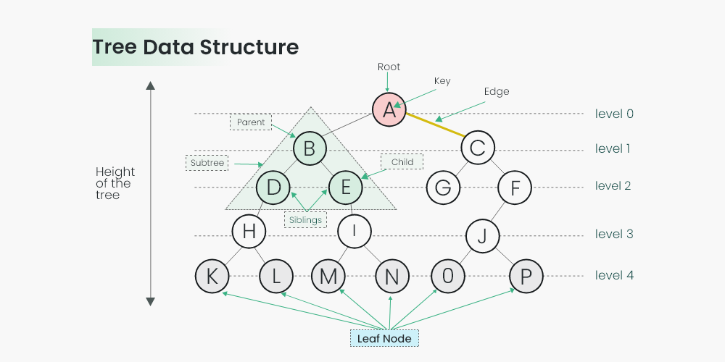
What is a tree? A collection of elements(nodes) linked together to simulate a hierarchy

Slide 5
TREE TERMINALOGIES
NODE
Elements from the tree are known as nodes
Node is an entity that contains keys and pointers to its child node

Slide 6
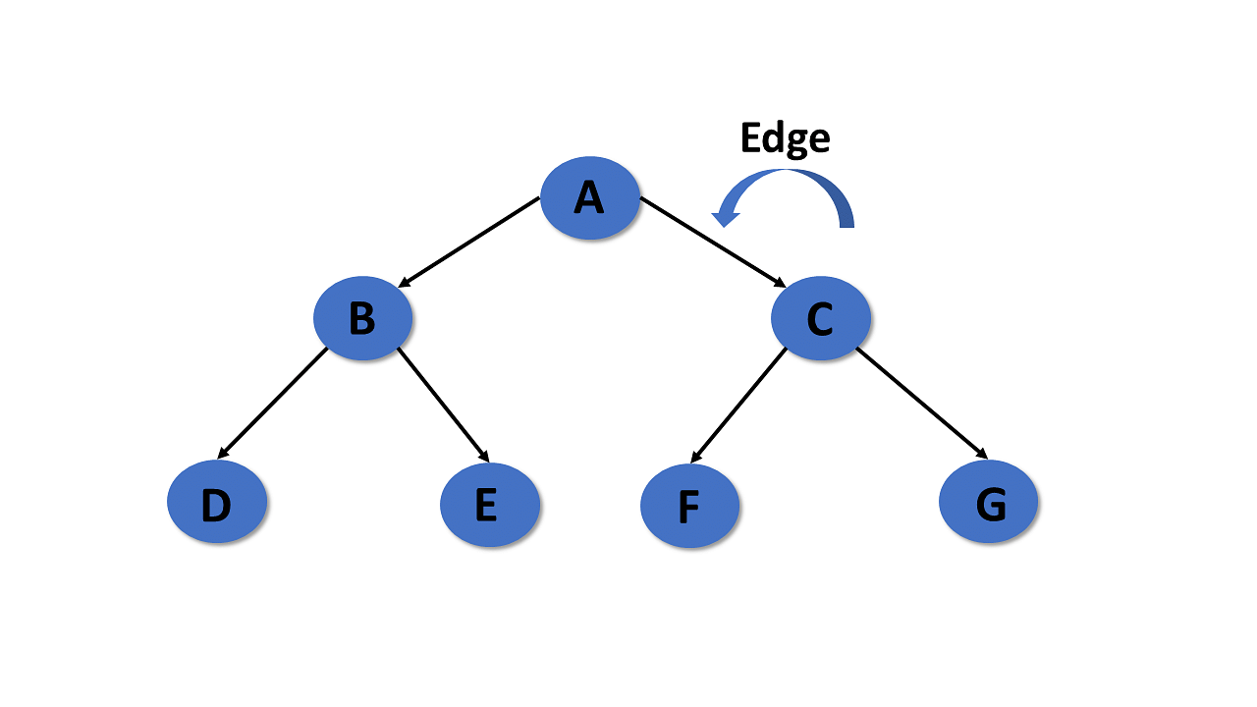
TREE TERMINALOGIES
In a tree in data structures, the connecting link of any two nodes is called the edge of the tree data structure.

Slide 7
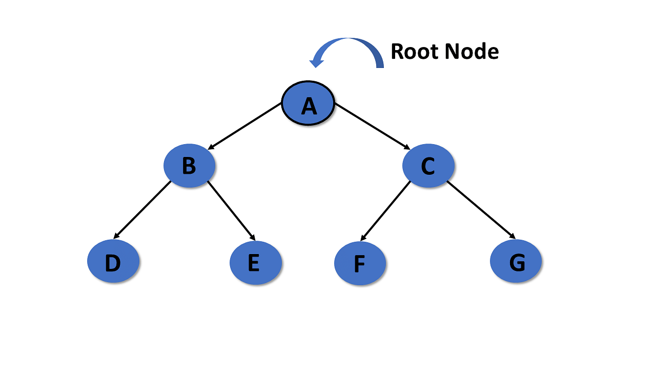
TREE TERMINALOGIES
In a tree data structure, the root is the first node of the tree. The root node is the initial node of the tree in data structures.

Slide 8
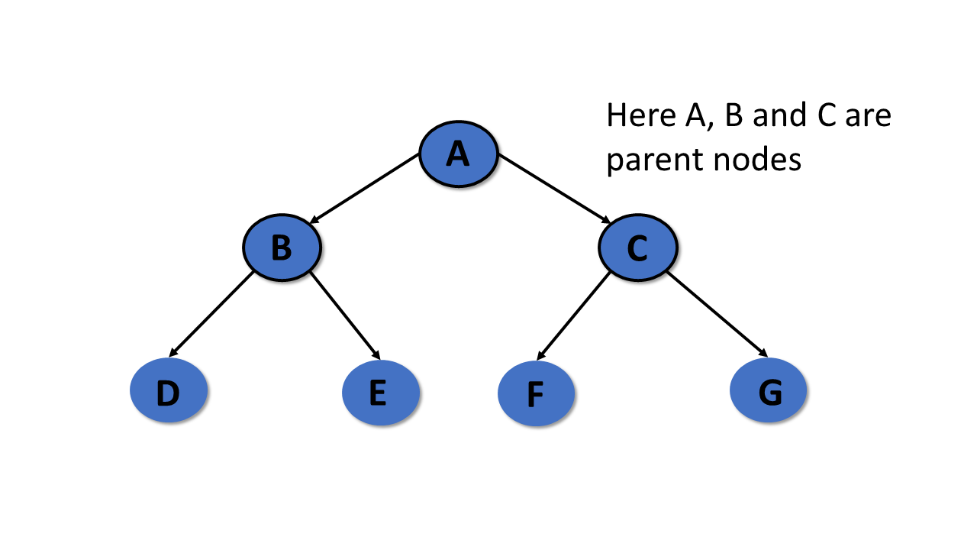
TREE TERMINALOGIES
In the tree in data structures, the node that is the predecessor of any node is known as a parent node, or a node with a branch from itself to any other successive node is called the parent node.

Slide 9
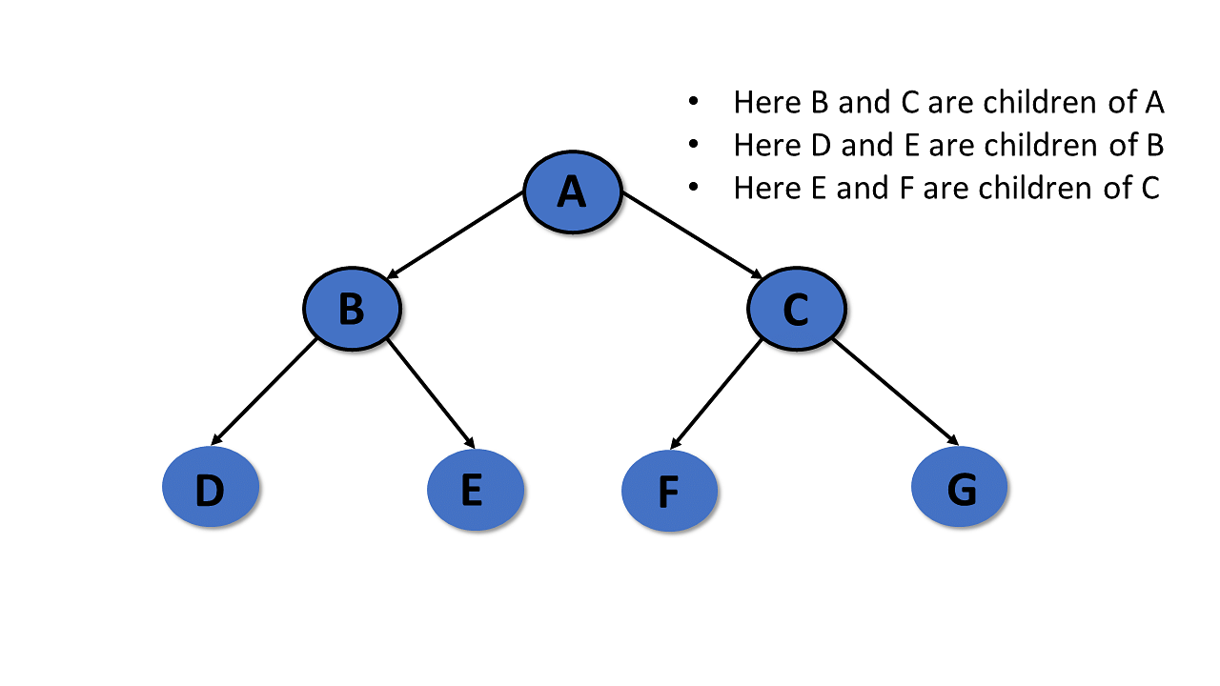
TREE TERMINALOGIES
a descendant of any node, is known as child nodes in data structures. Or the successor of a node

Slide 10
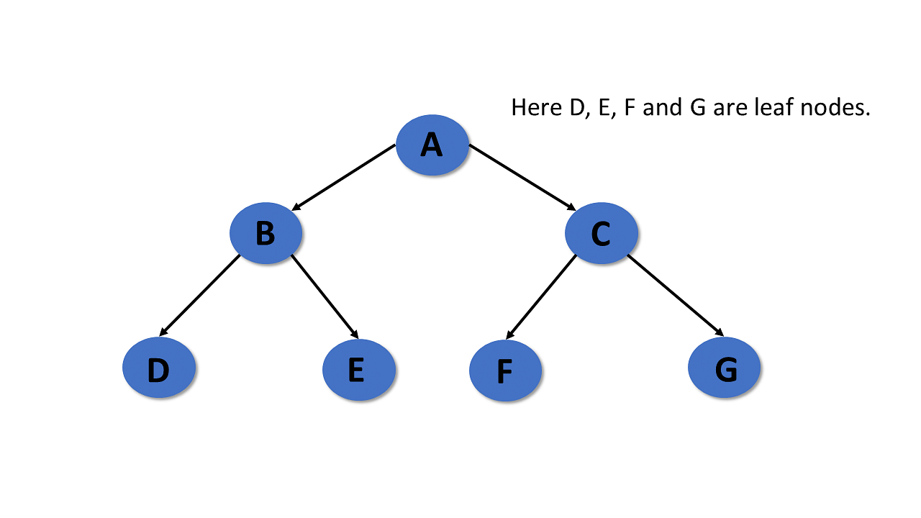
TREE TERMINALOGIES
The leaf node is the node with no child also known as an external node

Slide 11
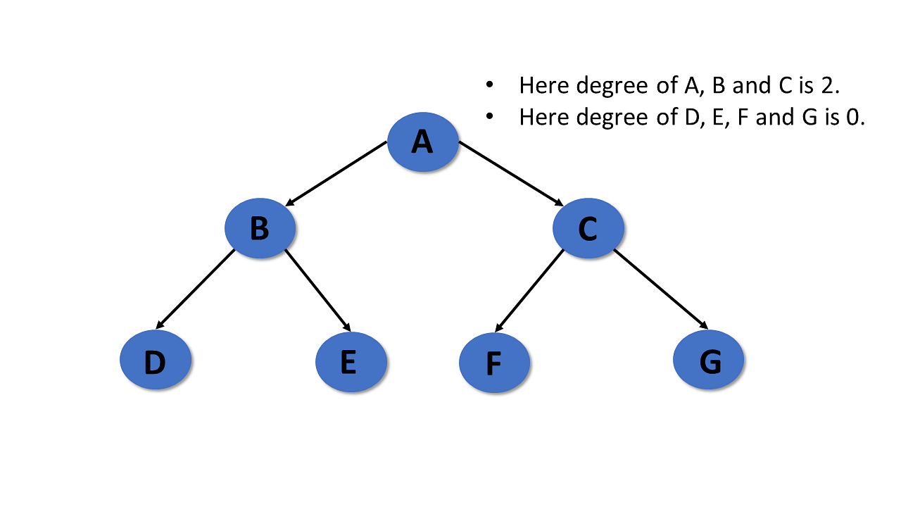
TREE TERMINALOGIES
In the tree data structure, the total number of children of a node is called the degree of the node

Slide 12
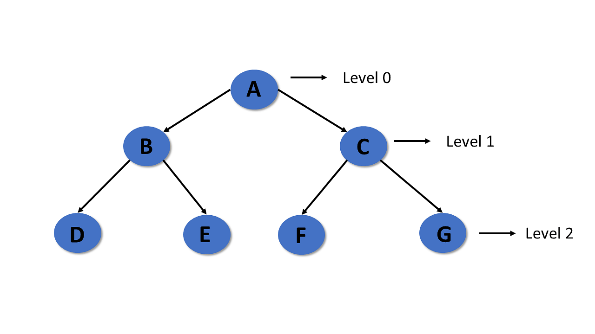
TREE TERMINALOGIES
In tree data structures, the root node is said to be at level 0, and the root node's children are at level 1, and the children of that node at level 1 will be level 2, and so on

Slide 13
TYPES OF TREES
BINARY TREE
BINARY SEARCH TREE
AVL TREE
B-TREE

Slide 14
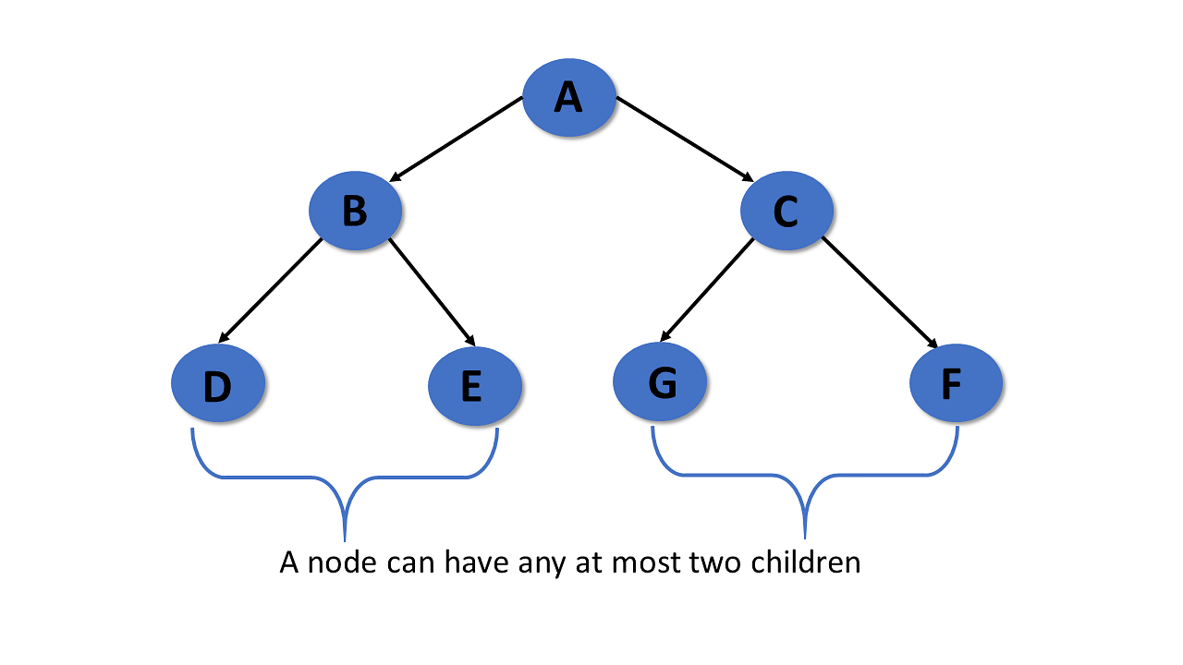
Binary Tree
A binary tree is a tree data structure in which each parent node at most has two children
The have at most two child node
This child notes are called left child and the right child

Slide 15
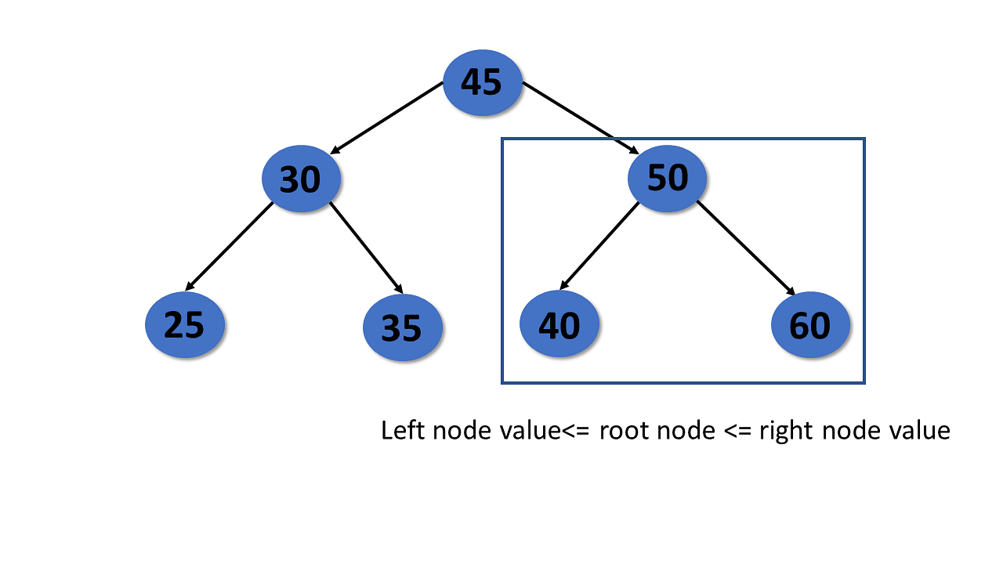
Binary search Tree
It is a tree in which each node have the maximum of two children
All nodes of the left sub-tree are less than the root node
All nodes of the right sub-tree are more than the root node

Slide 16
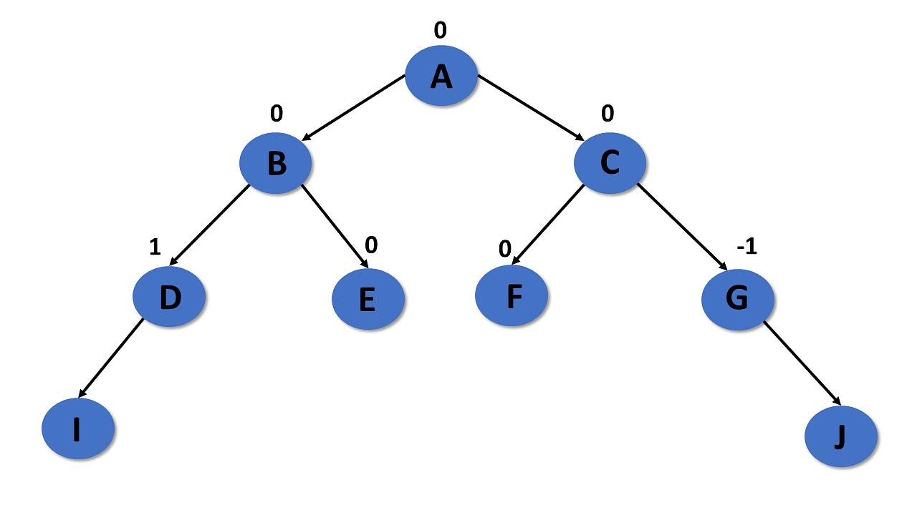
AVL TREE
An AVL tree is a type of tree that is a self-balancing binary search tree
Balance factor=(height of the left subtree)- (height of the right subtree)or (height of the right subtree)-(height of the left sub tree)

Slide 17
B-tree
It is a special self balancing tree in which each node has more than two children
B-tree is also known as the height balanced m-way treee

Slide 18
TREE TRAVERSAL
It is the process of visiting each node and print their values
Three types exist
Pre-order traversal
In-order traversal
Post-order traversal

Slide 19
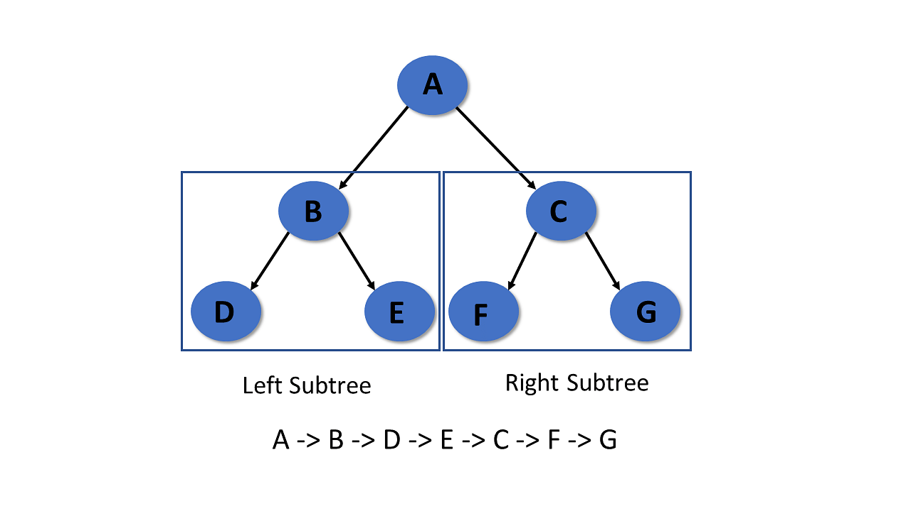
Pre-order traversal
In the preorder traversal,
The root node is visited first
Then left subtree
And the lastly right subtree

Slide 20

In-order traversal
In the in-order traversal,
The left subtree is visited first
Then the root node
And the right sub-tree

Slide 21

Post-order traversal
The left subtree is visited first
Then the right subtree
And the root node

Slide 22
Application of Tree in Data Structures
Binary Search Tree (BST) is used to check whether elements present or not.
Heap is a type of tree that is used to heap sort.
Tries are the modified version of the tree used in modem routing to information of the router.
The widespread database uses B-tree.
Compilers use syntax trees to check every syntax of a program.
With this, you’ve come to the end of this tutorial about the tree in data structures.

Slide 23
HASHING AND HASH TABLE
Defination:
Hashing refers to the process of generating a fixed-size output from an input of variable size using the mathematical formulas known as hash functions. This technique determines an index or location for the storage of an item in a data structure.
Need for Hash data structure
Every day, the data on the internet is increasing multifold and it is always a struggle to store this data efficiently. In day-to-day programming, this amount of data might not be that big, but still, it needs to be stored, accessed, and processed easily and efficiently. A very common data structure that is used for such a purpose is the Array data structure.

Slide 24
Now the question arises if Array was already there, what was the need for a new data structure! The answer to this is in the word “efficiency“. Though storing in Array takes O(1) time, searching in it takes at least O(log n) time. This time appears to be small, but for a large data set, it can cause a lot of problems and this, in turn, makes the Array data structure inefficient. So now we are looking for a data structure that can store the data and search in it in constant time, i.e. in O(1) time. This is how Hashing data structure came into play. With the introduction of the Hash data structure, it is now possible to easily store data in constant time and retrieve them in constant time as well.

Slide 25
Components of Hashing
Key: A Key can be anything string or integer which is fed as input in the hash function the technique that determines an index or location for storage of an item in a data structure.
Hash Function: The hash function receives the input key and returns the index of an element in an array called a hash table. The index is known as the hash index.
Hash Table: Hash table is a data structure that maps keys to values using a special function called a hash function. Hash stores the data in an associative manner in an array where each data value has its own unique index.

Slide 26
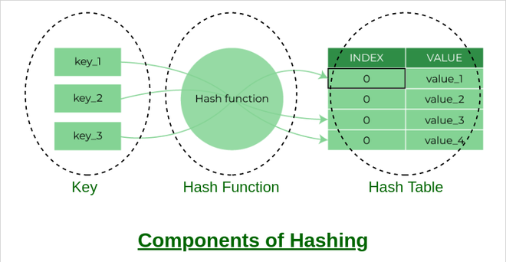

Slide 27
How does Hashing work?
Suppose we have a set of strings {“ab”, “cd”, “efg”} and we would like to store it in a table.
Our main objective here is to search or update the values stored in the table quickly in O(1) time and we are not concerned about the ordering of strings in the table. So the given set of strings can act as a key and the string itself will act as the value of the string but how to store the value corresponding to the key?
Step 1: We know that hash functions (which is some mathematical formula) are used to calculate the hash value which acts as the index of the data structure where the value will be stored.
Step 2: So, let’s assign
  “a” = 1,
  “b”=2, .. etc, to all alphabetical characters.
Step 3: Therefore, the numerical value by summation of all characters of the string:
“ab” = 1 + 2 = 3,
“cd” = 3 + 4 = 7 ,
“efg” = 5 + 6 + 7 = 18
Step 4: Now, assume that we have a table of size 7 to store these strings. The hash function that is used here is the sum of the characters in key mod Table size. We can compute the location of the string in the array by taking the sum(string) mod 7.
Step 5: So we will then store
  “ab” in 3 mod 7 = 3,
  “cd” in 7 mod 7 = 0, and
  “efg” in 18 mod 7 = 4.

Slide 28


Slide 29
What is a Hash function?
The hash function creates a mapping between key and value, this is done through the use of mathematical formulas known as hash functions. The result of the hash function is referred to as a hash value or hash. The hash value is a representation of the original string of characters but usually smaller than the original.
For example: Consider an array as a Map where the key is the index and the value is the value at that index. So for an array A if we have index i which will be treated as the key then we can find the value by simply looking at the value at A[i].
simply looking up A[i].

Slide 30
Types of Hash functions:
There are many hash functions that use numeric or alphanumeric keys. This article focuses on discussing different hash functions:
Division Method.
Mid Square Method.
Folding Method.
Multiplication Method

Slide 31
Properties of a Good hash function
Efficiently computable.
Should uniformly distribute the keys (Each table position is equally likely for each.
Should minimize collisions.
Should have a low load factor(number of items in the table divided by the size of the table).

Slide 32
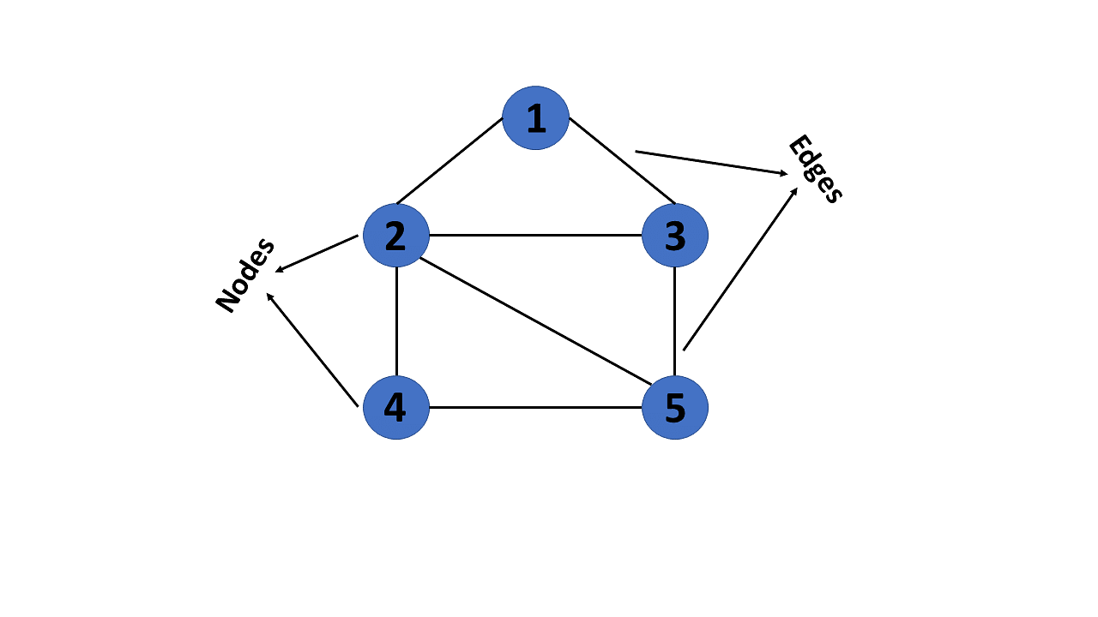
GRAPHS IN DATA STRUCTURE
What Are Graphs in Data Structure?
A graph is a non-linear kind of data structure made up of nodes or vertices and edges. The edges connect any two nodes in the graph, and the nodes are also known as vertices.
This graph has a set of vertices V= { 1,2,3,4,5} and a set of edges E= { (1,2),(1,3),(2,3),(2,4),(2,5),(3,5),(4,50 }.

Slide 33
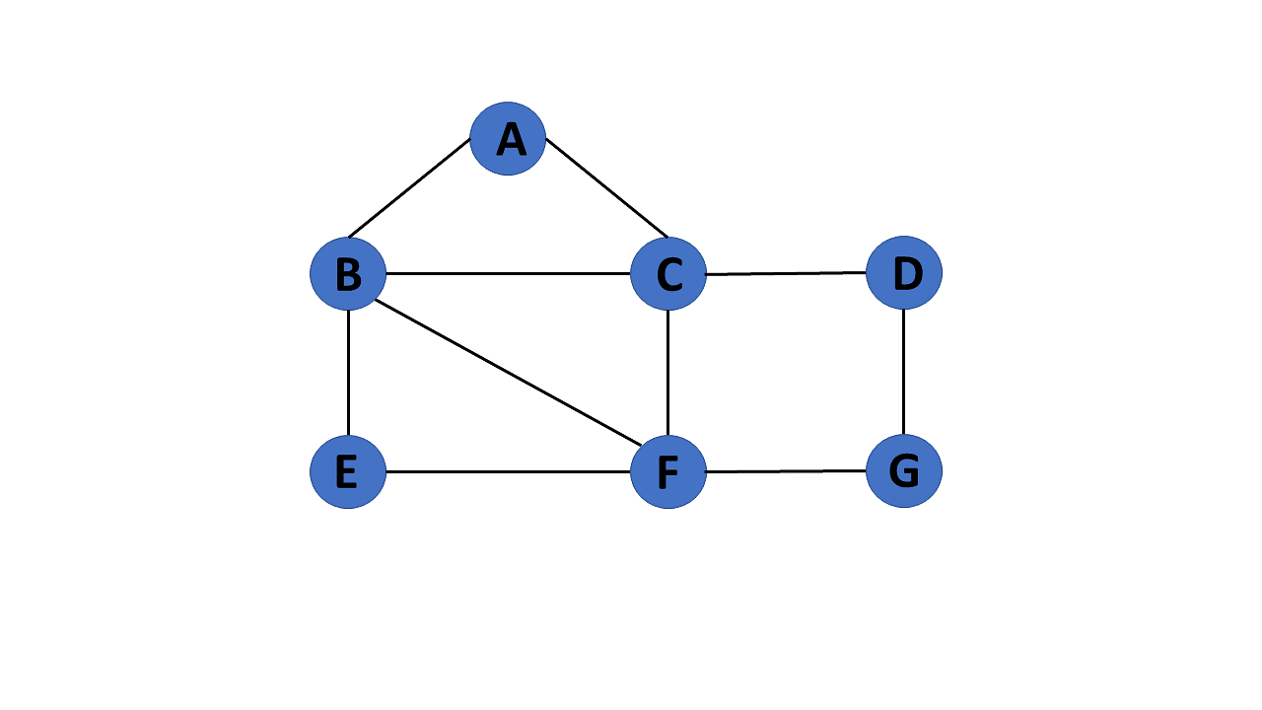
Types of Graphs in Data Structures
1. Finite Graph
The graph G=(V, E) is called a finite graph if the number of vertices and edges in the graph is limited in number

Slide 34
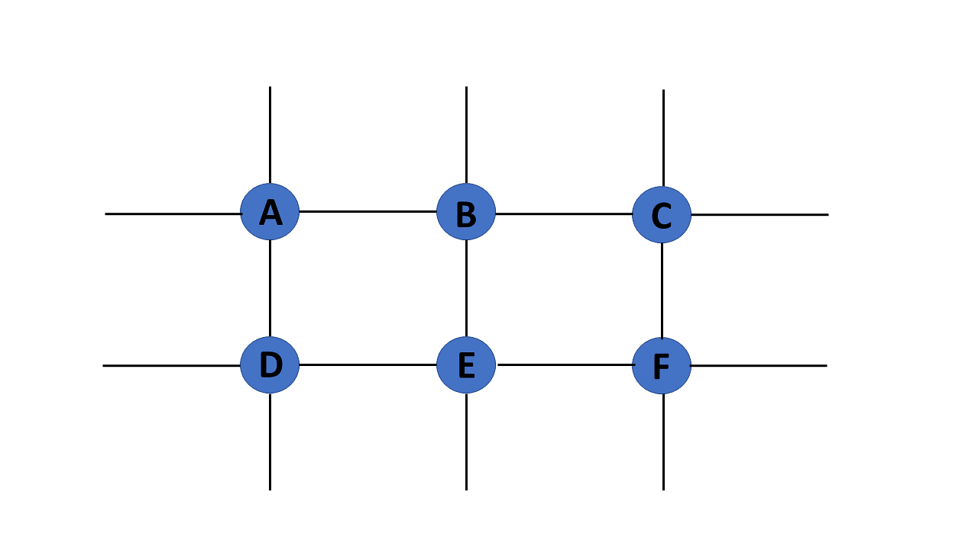
2. Infinite Graph
The graph G=(V, E) is called a finite graph if the number of vertices and edges in the graph is interminable.

Slide 35
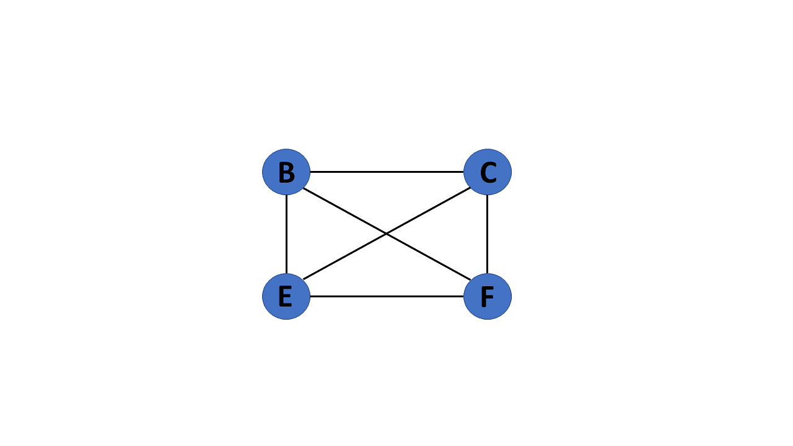
. Simple Graph
If each pair of nodes or vertices in a graph G=(V, E) has only one edge, it is a simple graph. As a result, there is just one edge linking two vertices, depicting one-to-one interactions between two elements

Slide 36
Representation of Graphs in Data Structures
Graphs in data structures are used to represent the relationships between objects. Every graph consists of a set of points known as vertices or nodes connected by lines known as edges. The vertices in a network represent entities.
The most frequent graph representations are the two that follow:
Adjacency matrix
Adjacency list

Slide 37
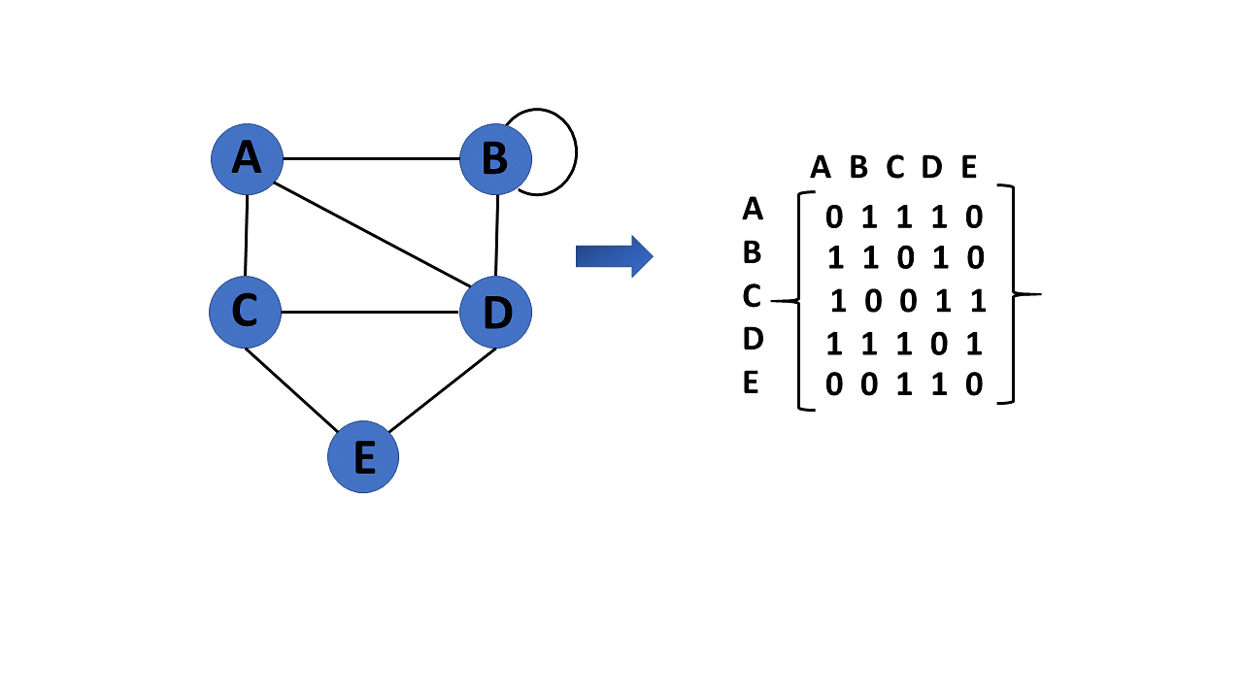
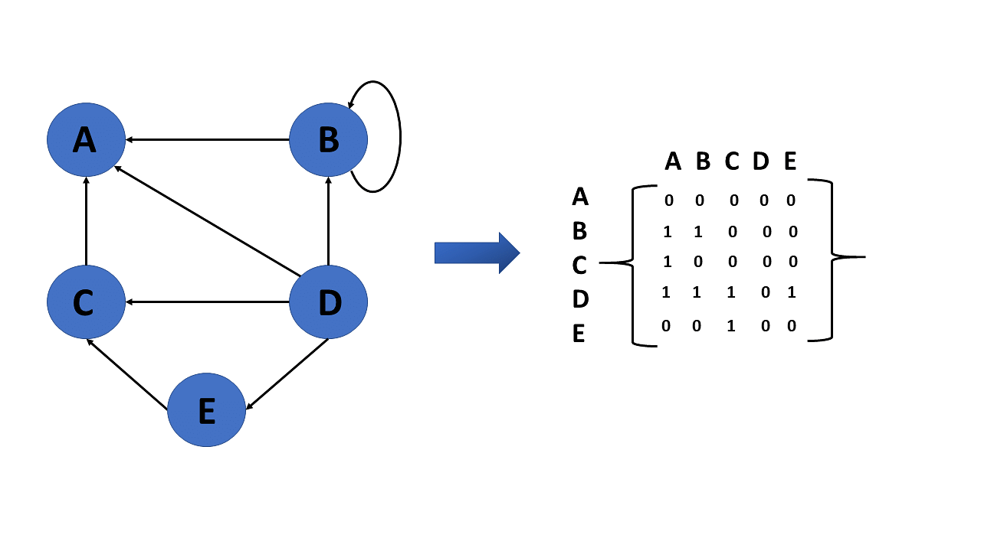
Adjacency Matrix
A sequential representation is an adjacency matrix.
It's used to show which nodes are next to one another. I.e., is there any connection between nodes in a graph?
You create an MXM matrix G for this representation. If an edge exists between vertex a and vertex b, the corresponding element of G, gi,j = 1, otherwise gi,j = 0.
If there is a weighted graph, you can record the edge's weight instead of 1s and 0s

Slide 38
Adjacency List
A finite graph is represented by an adjacency list, which is a collection of unordered lists. Each unordered list describes the set of neighbors of a particular vertex in the graph within an adjacency list.

Slide 39
Graph Traversal Algorithm
The process of visiting or updating each vertex in a graph is known as graph traversal. The sequence in which they visit the vertices is used to classify such traThere are two techniques to implement a graph traversal algorithm:
Breadth-first search
Depth-first search
versals. Graph traversal is a subset of tree traversal.

Slide 40
Application of Graphs in Data Structures
Graphs are used in computer science to depict the flow of computation.
Users on Facebook are referred to as vertices, and if they are friends, there is an edge connecting them.
The Friend Suggestion system on Facebook is based on graph theory.
You come across the Resource Allocation Graph in the Operating System,
where each process and resource are regarded vertically. Edges are drawn from resources to
assigned functions or from the requesting process to the desired resource.
A stalemate will develop if this results in the establishment of a cycle.

